Slide 1

Customer Shopping Behavior Analysis
Uncovering insights from transactional data.

Slide 2

Project Overview
Data Source
Goal
3,900 purchases across categories.
Uncover spending patterns, segments, preferences.
Impact
Guide strategic business decisions.

Slide 3

Dataset Summary
Key Features
Data Snapshot
Customer demographics (Age, Gender, Location, Subscription)
Rows: 3,900
Purchase details (Item, Category, Amount, Season, Size, Color)
Columns: 18
Shopping behavior (Discount, Promo, Previous Purchases, Frequency, Review, Shipping)
Missing Data: 37 values in Review Rating.

Slide 4
Exploratory Data Analysis (Python)
01
02
Data Loading
Initial Exploration
Imported dataset using pandas.
Checked structure and summary statistics.
03
04
Missing Data Handling
Column Standardization
Imputed Review Rating using median.
Renamed columns to snake case.
05
06
Feature Engineering
Database Integration
Created age_group and purchase_frequency_days.
Loaded cleaned data to PostgreSQL.

Slide 5

Data Analysis (SQL)
Key business questions answered through structured PostgreSQL analysis.
1
Revenue by Gender
Male: $157,890, Female: $75,191
2
High-Spending Discount Users
839 customers identified.
3
Top 5 Products by Rating
Gloves (3.86), Sandals (3.84), Boots (3.82).
4
Shipping Type Comparison
Express avg. $60.48 vs. Standard avg. $58.46.

Slide 6

SQL Insights: Subscription & Discounts
Subscribers vs. Non-Subscribers
Discount-Dependent Products
Yes
1053
59.49
62645
Hat (50.00%)
Sneakers (49.66%)
No
2847
59.87
170436
Coat (49.07%)
Sweater (48.17%)
Pants (47.37%)

Slide 7
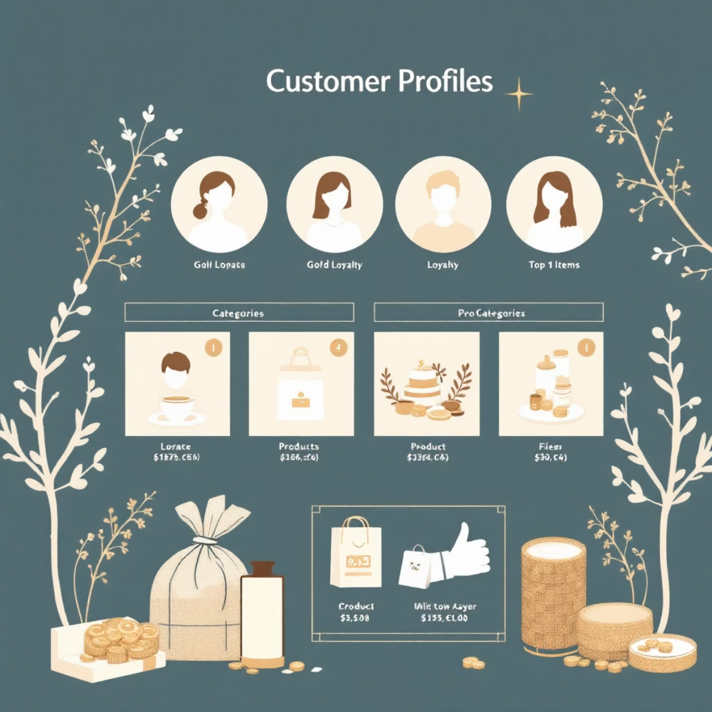
Customer Segmentation & Product Ranking
Customer Segments
Top 3 Products per Category
Loyal
3116
Accessories: Jewelry, Sunglasses, Belt
Clothing: Blouse, Pants, Shirt
New
83
Footwear: Sandals, Shoes, Sneakers
Returning
701
Outerwear: Jacket, Coat

Slide 8

Repeat Buyers & Revenue by Age
Repeat Buyers & Subscriptions
Revenue by Age Group
Customers with >5 purchases:
Young Adult
62143
No Subscription: 2518
Yes Subscription: 958
Middle-aged
59197
Adult
55978
Senior
55763

Slide 9
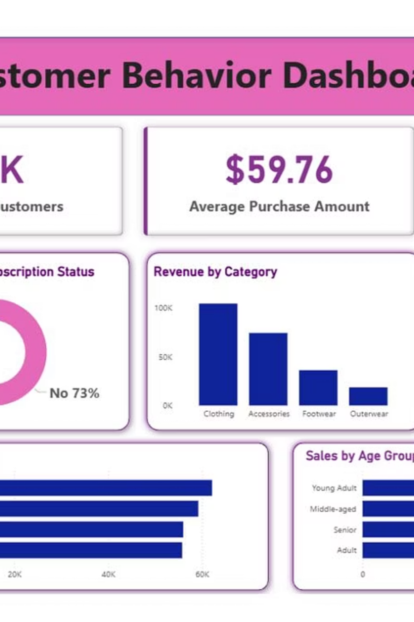
Interactive Dashboard in Power BI
Visualizing insights for strategic decision-making.
The dashboard provides a dynamic view of customer behavior.

Slide 10

Business Recommendations
Boost Subscriptions
Promote exclusive benefits.
Customer Loyalty Programs
Reward repeat buyers.
Review Discount Policy
Balance sales with margin control.
Product Positioning
Highlight top-rated products.
Targeted Marketing
Focus on high-revenue age groups.

